Slide 1
Information Processing Techniques
Week 05
Abeeha Sattar

Slide 2
Windows Services
USING C #
Notes:
Launch Mechanism – A regular application is manually launched by the end user from the desktop or Start Menu. Examples include web browsers,
User Interface –
Multiple Instances – Only one instance of a Windows Service runs on a device. Regular applications can allow multiple copies if several users are logged into the same machine.
Administrator Rights – Windows Services usually run under administrative privileges even when a non-administrator user is logged in and using the computer. The average Windows Service has more control over the machine compared to a regular application.
Installer?
Drivers?
Plug n Play devices (Mouse)
Printer availability
iTunes (connectivity with mobile and transfer or files)
Windows Update

Slide 3
Windows Services
A Windows service is a long-running program
It is designed to run as a background task with no interaction with the screen
UNIX calls these processes daemons
They often implement key system tasks such as
Anti Virus
Indexing
DNS
time synchronization
SSH
HTTP
IIS, etc.
Notes:
SSH = Secure Shell

Slide 4
Windows Services
Configurable
Runs on startup (computer boot)
Delay Run
Manual / Auto Run
Start with parameter
Starts for specific username

Slide 5
View Windows Services
Command Prompt
Task Manager
Services Manager
Computer Manager

Slide 6
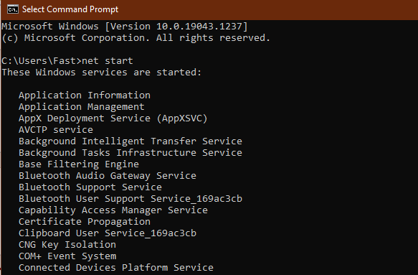
View Windows Services – Command Prompt
Using the “net start” command in the command prompt

Slide 7
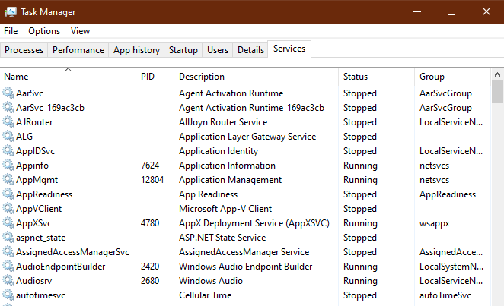
View Windows Services – Task Manager
“Services” tab in the Task Manager

Slide 8
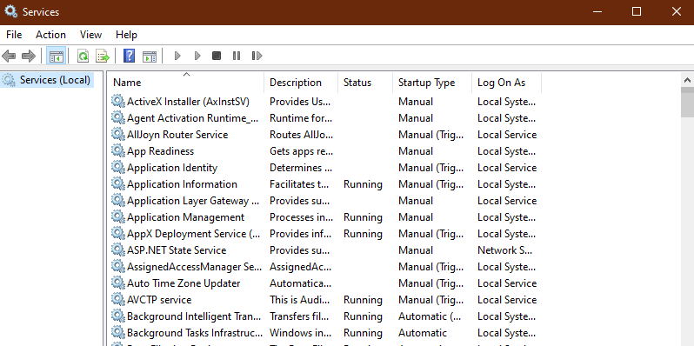
View Windows Services – Services Manager
Run > services.msc

Slide 9
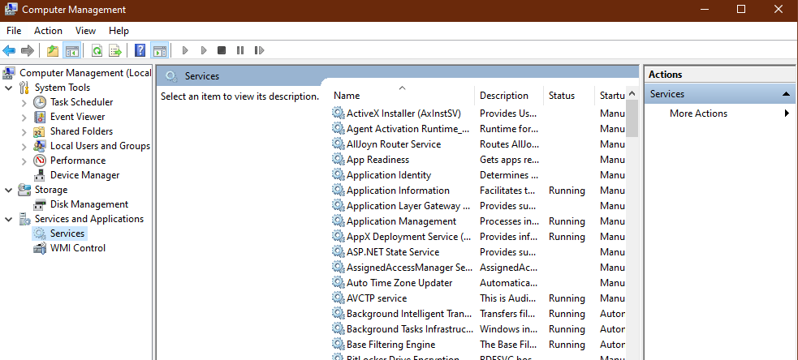
View Windows Services – Computer Manager
Computer Management: Services and Applications Section

Slide 10
Understanding Windows Services
Service Status
Started
Pause
Pending
Stop
Service Start Mode
Automatic
Manual
Delay Start
Disabled
Start As/By
Local System
Local Service
Network Service
Notes:
Local System is a very high-privileged built-in account. It has extensive privileges on the local system and acts as the computer on the network. The actual name of the account is "NT AUTHORITY\SYSTEM".
The Local Service account is a built-in account that has the same level of access to resources and objects as members of the Users group. This limited access helps safeguard the system if individual services or processes are compromised. Services that run as the Local Service account access network resources as a null session without credentials.The actual name of the account is "NT AUTHORITY\LOCAL SERVICE".
The Network Service account is a built-in account that has more access to resources and objects than members of the Users group. Services that run as the Network Service account access network resources by using the credentials of the computer account. The actual name of the account is "NT AUTHORITY\NETWORK SERVICE"

Slide 11
ServiceBase Class
The ServiceBase class is in the System.ServiceProcess namespace
All services are derived from this class
It provides several methods which should be overloaded to define the actions of the service

Slide 12
ServiceBase Methods
void OnStart(string[] args)
This is sent by the system when the service is started
Normally, the work performed by the service will be done by this method
void OnPause()
Called when the service is paused
A service is usually resumed after a pause and it is not necessary to release all resources held by the service

Slide 13
ServiceBase Methods
void OnContinue()
This resumes normal processing after the service has been paused
void OnStop()
This attempts to stop the service
The service might be started again at a later time

Slide 14
ServiceBase Properties
ServiceName
Allows the name of the service to be set or retrieved
CanStop
Boolean indicating whether the service can be stopped

Slide 15
Sample Service
We will now write a sample service
We must provide
A service
A main program for the service
A service installer
Our sample service will periodically write the time to a file

Slide 16
Service1
The constructor
public Service1()
{
InitializeComponent();
this.ServiceName = "WindowsService1";
}

Slide 17
Service1
protected override void OnStart(string[] args) {
try {
writer = File.CreateText(@"c:\service1.log");
timer = new System.Threading.Timer(new
System.Threading.TimerCallback(TimerHandler),
null, 1000, 10000);
}
catch (Exception e1) {}
}

Slide 18
Service1
protected override void OnStop() {
if (writer != null) {
try {
writer.Close();
writer = null;
}
catch (Exception e2)
{}
}
}

Slide 19
Service1
void TimerHandler(object info) {
if (writer != null) {
writer.WriteLine("It is now {0}",
DateTime.Now);
}
}

Slide 20
Main
static void Main()
{
ServiceBase[] ServicesToRun;
ServicesToRun = new ServiceBase[] { new Service1() };
ServiceBase.Run(ServicesToRun);
}
Notes:
Every service must have a main method

Slide 21
Installing the Service
Before you can install the service, you must write an installer
This extends System.Configuration.Install.Installer
It is included in the same assembly as the service it should install
It installs the service by using the service name, which must be set in the service

Slide 22
Installing / Uninstalling the Service
To install the service use installutil which is located in
C:\WINDOWS\Microsoft.NET\Framework\<version>
installutil <service.exe>
To uninstall the service, use installutil /u <service.exe>

Slide 23
Installing the Service
To install the service
Start a command prompt and go to the directory containing the service assembly
installutil WindowsService1.exe
To start the service
Start the services control panel and click start
To uninstall the service
installutil /u WindowsService1.exe
Notes:
Why would you want to uninstall your services?

Slide 24
Task Scheduler
The task scheduler is a tool included with Windows that allows predefined actions to be automatically executed whenever a certain set of conditions is met.
Let’s try scheduling a task!

Slide 25
Windows Service v/s Task Scheduler
Windows Service | Task Scheduler
Running a permanent or continuous operation/ task | Running a program/app once in a while (on frequency basis)
When a service is required to provide data/operation when needed/triggered | Running at its own pace. Processes and provides output but is not dependent on other programs/inputs
Complex program and/or application that is very complex in coding and processing | Simple operation or program that can be easily managed
Triggered via events or programs | Triggered via time

Slide 26
Fin.

